Slide 1
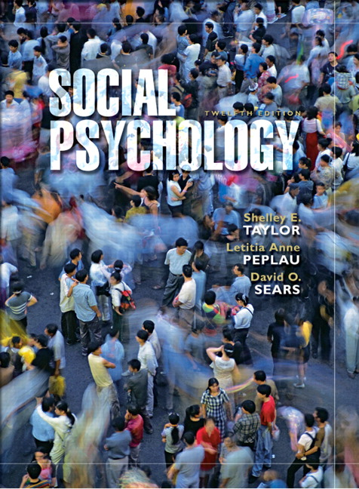
Chapter 8
        Interpersonal Attraction
Infant Attachment
Loneliness
Interpersonal Attraction
Mate Selection
Romantic Love
Taylor, Copyright 2006, Prentice Hall

Slide 2
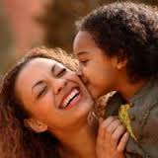
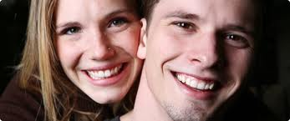
Interpersonal Attraction- Social Needs
Humans- social animals
(has evolutionary basis).
Infants rely on others to feed & care for.
Infants- innate tendency to look at faces
& form emotional bonds with their caregivers.
Throughout life people seek companions, friends & lovers.
Most people spend about 3/4s of their time with other people.
People want not merely the presence of others but close ties to people who care about them.
Need to belong- universal need (Baumeister & Learly, 1995)

Slide 3
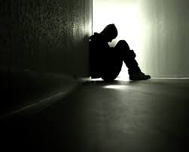
Interpersonal Attraction-Loneliness
Loneliness & social rejection-
as major source of personal distress
Loneliness: The subjective discomfort we
feel when our social relations lack some
important feature.
May be qualitative or quantitative
Different from aloneness (the objective state of being apart from others)
People are somewhat more likely to feel lonely when they are alone (if social norms dictate that one “should” be with others ; e.g., Saturday night)

Slide 4

Interpersonal Attraction-Loneliness
About 1 in 4 Americans reports feeling very lonely or remote in the past 2 weeks (Perlman & Peplau, 1998)
Situational loneliness- occurs due to life changes
Ex: moving to a new town, ending an important relationship, physical illness, serious accident etc…
Most people recover from situational loneliness.
Chronic loneliness- occurs for many years, regardless of the situation.
‘Lonely person’- 10% of the Americans suffer fom severe/ persistent loneliness.
Associated with depression,
alcohol & drug abuse, low grades,
poorer health, hospitalization &death
(among elderly)

Slide 5
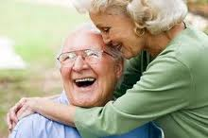
Interpersonal Attraction-Loneliness
No segment of society is immune.
Children of divorced parents, shy people, people with lower self-esteem, poor people, & single people- more at risk!
Contrary to stereotype, teenagers & young adults are more at risk than the elderly.
      - 79% under age 18
      - 53 % age 45-54
      - 37% over 55
Possible explanations;
“generation gap” in willingness to report feelings,
a function of greater life transitions among the young,
greater social skills & more realistic expectations among the elderly.

Slide 6
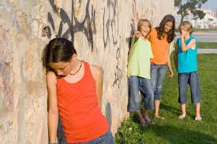
Interpersonal Attraction-Social Rejection
Social exclusion; effective form of punishment
Silent treatment- used at West Point & other military academies
Ostracism: experience of being ignored/ rejected by others.
Williams et al. (2001)- computer game involved involved throwing disc. ;
Three experimental conditions;
- equal inclusion to the game (%33)
- partial ostracism (%20)
- full ostracism (never thrown the disc)
Part.s in the ostracism conditions- a sense of exclusion, decrease in mood & self-esteem.
Ostracism may heighten our attention to social info. & greater monitoring of social beh.
Social rejection- decreased level of internal control & reveal anger & agressiveness

Slide 7
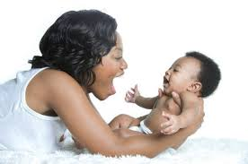
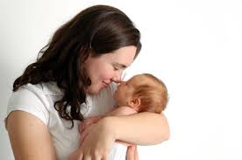
Interpersonal Attraction-Infant Attachment
Infants emotionally attach to people with whom they interact most often & most lovingly.
Attachment ; strong emotional bond - an infant responds positively to specific others (feels better when they are close & seeks them out when frightened)
Four important features of attachment;
    Proximity maintenance
    Seperation distress
    Safe haven
    Secure base

Slide 8
Interpersonal Attraction-Infant Attachment
Infants emotionally attach to people with whom they interact most often & most lovingly.
Attachment ; strong emotional bond - an infant responds positively to specific others (feels better when they are close & seeks them out when frightened)
Four important features of attachment;
    Proximity maintenance
    Seperation distress
    Safe haven
    Secure base

Slide 9
Interpersonal Attraction- Infant Attachment
Mary Ainsworth (1978): three attachment styles;
                - Secure: parent available & responsive to child feels supported, secure
                - Avoidant: parent cool, unresponsive, rej rejecting. Child supresses vulnerability & b becomes self-reliant.
                - Anxious/ambivalent: parent anxious,
                not consistent. Child viligant for theats,
                anxious/ angry.
  http://www.youtube.com/watch?v=DH1m_ZMO7GU
Attachment is adaptive (critical survival value)
The tendency to form relationships is at least partly biologically based.
Attachment allows infants to feel comfortable & safe.

Slide 10
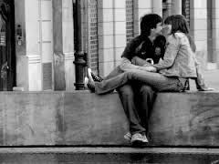
Interpersonal Attraction- Adult Attachment
Adult love rel.s similar to infant attachments (Hazan& Shaver, 1987)
Adult attachments also have a biological origin origin.
- Adult attachment similar to infant attachment attachment.
- Reciprocal, formed btw. peers & involve
sexual attraction.
Working Model of Relationships: beliefs about whether other people are trustworthy, responsive, caring.
Child’s attachment influence his/her romantic rel.s in adulthood.
(Secure infant attachment →secure attachment to romantic partner etc…)
20 years longitudinal study (Waters et al., 1995);
  72 % of the part.s had the same pattern of attachment when no neg. major attachment rel. event
  44% of the part.s same pattern when experienced neg. attachment as infant.
.

Slide 11
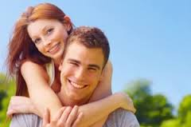
Interpersonal Attraction- Adult Attachment
Adult love rel.s similar to infant attachments (Hazan& Shaver, 1987)
- Secure: Comfortable with intimacy, see
the themselves as worthy of being loved & cared for cared for. (59%)
- Describe rel.s as happy, friendly & trusting.
- Share ideas & feelings with the partner
- Describe parents in pos. terms.
Avoidant: uncomfortable with getting close & trusting (25%).
Emotional highs & lows, jealousy & fear of intimacy
Deny attachment needs, focus on work, less personally revealing, engage in causal sexual encounters
Describe parents as demanding, critical & uncaring.

Slide 12
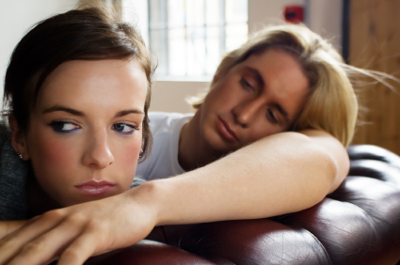
Interpersonal Attraction- Adult Attachment
Adult love rel.s similar to infant attachments (Hazan& Shaver, 1987)
Anxious/Ambivalent: Seek intimacy but worr worry that others won’t reciprocate their love.
the (11%)
- extreme sexual attraction, obsession, emotional emotional highs & lows
- More likely to fall love in first sight.
- Describe parents as demanding, parents marriage as unhappy.
Securely attached people- satisfying, committed, close rel.s than avoidant people.
Report high levels of intimacy, enjoyment & pos. emotions in their contacts with other people (Tidwell, Reis & Shaver, 1996)
Avoidant people- less intimacy & enjoyment, feeling more tense, worried & bored. (Tidwell, Reis & Shaver, 1996)

Slide 13
Interpersonal Attraction-Attraction
Why do we like some people and not others?
Basic Principles of Attraction;
In general…
  We like people who like us.
  We like people who satisfy our needs.
  We like people when the rewards they provide outweigh the costs (Social Exchange Theory)
Specific Determinants of Liking;
  Proximity
  Familiarity
  Similarity
  Personal Qualities of the Other

Slide 14
Interpersonal Attraction-Attraction
Proximity: Liking those nearby
If 2 people live on different sides of the same city, it is unlikely that they will be friends (e.g., dorms).
Festinger et. al (1950)- “friendships are likely to develop on the basis of brief and passive contacts made going to and from home or walking about the neighborhood’.
Studied the effects of proximity in Westgate West.
Some months after participants were asked to list their three closest friends.
42% direct neighbors, 7 friends with 6 & 8
1 and 5 turned out to be the most popular,
(not because they were kinder or more interesting, but because they lived at the bottom of the staircase that their upstairs neighbors were forced to use to reach the building’s second floor).

Slide 15
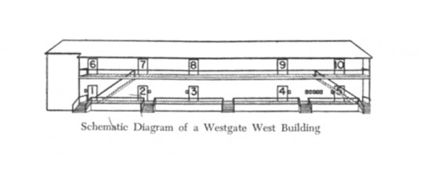
Interpersonal Attraction-Attraction
Proximity: Liking those nearby

Slide 16
Interpersonal Attraction-Attraction
Explanation:
Social Exchange Theory: Availability of people – less costly
Ex: Little effort to chat with a neighbour; Long distant rel.s require time, money & planning.
Cognitive Dissonance Theory: It is distressing to live side by side with someone we dislike.
Experience cognitive pressure to re-evaluate them & see some good qualities.
Limits to proximity effect:
Most likely to foster attraction when people have similar attitudes
When there is initial conflict- intensifies neg. feelings.

Slide 17
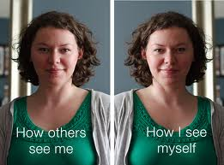
Interpersonal Attraction-Attraction
Familiarity: Liking those we see often
Familiarity enhances interpersonal attraction.
Mere Exposure Effect: Repeated exposure to a person increases our liking of that person.
Zajonc (1968); Showed pictures of faces to participants
- The more often subjects had seen a face, the more they said they liked it.
Mita et al. (1977); People’s reaction to their own faces
- Participants preffered their mirror image while their friends preffered the image from the perspective they were used to.

Slide 18
Interpersonal Attraction-Attraction
Explanation:
Evolutionary psychology: humans have innate fear of the unfamiliar .
(Strangers & unfamiliar objects may represent a threat)
Familiarity people or things produce feelings of comfort & security.
Limits to Mere Exposure Effect:
Exposure is effective in enhancing liking for a person which is initially perceived as pleasant & neutral.
(not for one that is initially perceived as negative).
A lot of repetition may cause boredom

Slide 19
Interpersonal Attraction-Attraction
Similarity: Liking people like us
We tend to like people who are similar to us in certain respects (attitudes, background, interests, personality etc…)
Newcomb (1961); similarity leads to firendship
- Rented a house near university of Michigan & offered free housing tpo participants.
- Designed rooms (some roommates had similar attitudes& some roommates different attitudes)
- Participants with similar attitudes liked each other & ended as friends.
Matching Principle: Tendency to choose similar partners.
We tend to date & marry partners who are similar to us in attitudes, values & background.

Slide 20
Interpersonal Attraction-Attraction
Explanation:
Several mechanisms involved (Aron, 1988)
Selective Attraction: Similarity used for screening potential dates & friends.
Social Influence: Partners who are initially different in attitudes may gradually persuade each other to change their views.
Environmental Factors: People with similar attitudes are more likely to meet with each other.
Limits to Similarity Effect:
Sometimes differences among people is very rewarding
Joy of friendship include stimulation & novelty
Different but complementary

Slide 21
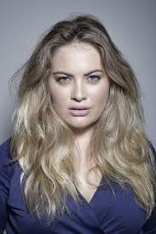

Interpersonal Attraction-Attraction
Desirable Attributes: Warmth & Competence
What makes us like one person more than other?
No objective answer
(Some people find red hair & freckles irresistible, others dislike them intensely)
Cultural differences ;
In U.S.A. – beauty associated with being thin; other societies consider plump women desirable.
Some general characteristics associeted with liking:
    Personal warmth
    Competence

Slide 22
Interpersonal Attraction-Attraction
Warmth
People appear warm when they have a positive attitude & express liking, praise, and approval
Nonverbal behaviors such as smiling, attentiveness, expressing emotions contribute to perceptions of warmth
Competence
We like people who are socially skilled, intelligent, and competent.
The type of competence that matters most depends on the nature of the relationship.
Ex: social skills for friends, knowledge for profs
Being “too perfect” can be off-putting!

Slide 23
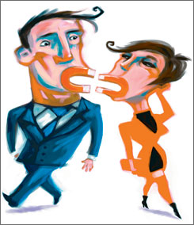
Interpersonal Attraction-Attraction
Fatal Attraction: The personal qualities that initially attract us can sometimes turn out to be fatal flaws to a relationship
Ex: the “fun-loving” boyfriend who is later dismissed as “immature”
    About 30% of breakups fit this description.

Slide 24
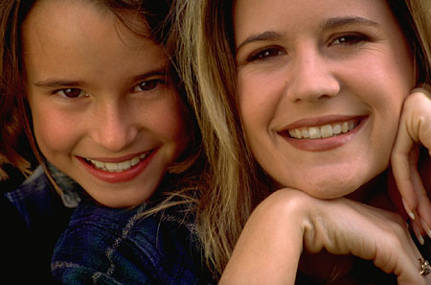

Interpersonal Attraction- Physical Attractiveness
We can hardly avoid forming impressions of people on their physical appearance.
Beauty does indeed make a difference in social life.
Other things being equal, we tend to like attractive people more.
Why?
They are believed to possess other good qualities.
(socially skilled, friendly, more vain & sexually promiscous)
Attractive children- perceived more popular by their peers.
Atrractive adults – believed to possess qualities irrevelant to physical beauty.
(intelligent, dominant, & mentally healthy).

Slide 25
Interpersonal Attraction- Physical Attractiveness
Walster et al. (1966)- importance of attractiveness in dating
  College students were randomly assigned to each other as dates for an evening.
  Researchers made ratings of physical attractiveness of each male & female participant
  People who were more attractive were better liked by their date.
Physically attractive people are more likely to;
  receive help,
  - job recommendations &
  more lenient punishments

Slide 26
Interpersonal Attraction- Physical Attractiveness
People who are disabled are stereotyped as unattractive.
Ash & Fine (1986)- stereotypes about women with disabilities
  Women- soft, loveable, married & intelligent
  Disabled women- ugly, lifeless, lonely, someone to feel sorry for.
People who are obese are stigmatized & face discrimination in the workplace.
Perceived as less sexually atrractive, skilled & warm
The negative view occurs because people are seen as responsible for their weight.
Anti-fat prejudice is strongest in individualistic cultures (e.g. U.S. ) than collectivist cultures (e.g. Mexico). (Crandall et al., 2001).

Slide 27
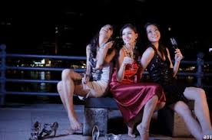
Interpersonal Attraction- Physical Attractiveness
Why does attractiveness matter?
People believe attractiveness is correlated with other positive characteristics.
Evolutionary theory- attractiveness may provide a clue to health and reproductive fitness
- Pretty face- marker of good genes
Radiating Effect of Beauty: Being associated with an attractive other leads a person to be seen as more attractive him or herself
But only when the two are friends, not strangers !
No gender differences found!

Slide 28
Interpersonal Attraction- Mate Selection
When asked what they seek in a long-term partner or mate people go beyond physical attractiveness.
Personal qualities – warm, kind & trustworthy
Longitudinal Study (from 1930s- 1990s)- For both sexes, characteristics such as dependability, maturity & pleasantness are most important.
Little importance given to similar political, educational & religous background.
Changing trends;
  Increasing importance given to mutual love & attraction
  Physical attractiveness increased in importance

Slide 29
Interpersonal Attraction- Sex Differences
Consistent sex diffrences found in the qualities people value in mate.
Men- rank physical attractiveness higher.
Women- more willing to marry someone who is not good looking
Men- prefer younger partners while women prefer older partners.
Women -rank financial resources higher.
Men- more willing to marry someone who had less education, earned less & unstable job.
Physical attractiveness - necessity by men & luxury by women
Partner’s status- necessity by women & luxury by men
Sociocultural Explanation- Women & Men have different traditional social roles
Evolutionary Explanation- different mate selection for maximizing reproductive success.

Slide 30
Interpersonal Attraction- Love
Arranged Marriages vs. Love Matches
Most people in the today believe that love is essential for a successful marriage.
In the U.S., love is seen as more important today than it was in the 1960s.
  In 1960s- Most men said they would not marry a women they did not love but most women were undecided
  Today, most women & men said they would not marry without love, sex differences dissappeared.
Cultural differences;
Romantic love is seen as more important in individualistic cultures (e.g., U.S., England) than it is in collectivist cultures(e.g. ,India, Thailand, Pakistan).
India-marriages arranged by parents (bride- domestic skills, obedience, religiousness, good character; groom- ses & education)
The rate of divorce found to be higher than individualist cultures.

Slide 31
Interpersonal Attraction- Love
Researchers have begun to identify the various feelings, thoughts & beh.s associated with romantic love.
Feelings of Love
 | % reporting
Strong feeling of well-being | 79
Difficulty concentrating | 37
“Floating on a cloud” | 29
“Wanted to run, jump, & scream” | 22
“Nervous before dates” | 22
“Giddy & carefree” | 20
Strong physical sensations (e.g., butterflies in the stomach) | 20
Insomnia | 12
Gender differences found; women were more likely to report strong emotional reactions than men

Slide 32


Interpersonal Attraction- Love
Thoughts of Love
Rubin (1970, 1973)- typical thoughts of people in love.
Three basic themes:
  Attachment- sense of needing the partner & one’s dependence on the other
  Caring- desire to promote other’s welfare & responsive to other’s needs
  Trust & Self-Disclosure- whether one trusts his/her partner/confidence in the partner

Slide 33
Interpersonal Attraction- Love
Behaviors of Love
Swensen (1972)- asked people what beh.s they thought were most associated with love for romantic partner.
Seven categories;
  Verbal expressions, e.g., “I love you.”
  Physical expression, e.g., hug & kiss
  Verbal self-disclosure
  Nonverbal display of happiness near other
  Material signs, e.g., presents, helping
  Nonmaterial signs, e.g., encouragement, interest, respect
  Making sacrifices to maintain the relationship
Many of these romantic love beh.s were also seen as signs of love for parents, siblings & same-sex friends.

Slide 34
Interpersonal Attraction- Love
Passionate Love & Companiate Love
People differ in their specific love experiences,
There are different types of love.
Passionate Love
Sexual feelings, anxiety & relief, alturism & jealousy coexist.
  Wildly emotional
  Uncontrollable
  Physiological arousal
  Preoccupation with other
  Idealization of other
Strikes suddenly, fades quickly
Companionate Love
The affection we feel for those with whom our lives are deeply intertwined.
  Trust
  Caring
  Tolerance
Develops slowly, basis for enduring relationship

Slide 35
Interpersonal Attraction- Love
Triangular Theory of Love
Sternberg (1986)- all love experiences have three components
( the points of a triangle).
  Intimacy: Feelings of closeness, connectedness & bondness
  Wanting to care for partner, self-disclosure & communication.
  Passion: Intense emotions, physical attraction & sexuality
  Commitment: the decision that one loves the other & maintain the love.

Slide 36
Interpersonal Attraction- Love
Triangular Theory of Love
Seven distinct types of love:
  Liking: intimacy without passion or commitment (eg. Friendship
  Infatuated Love: of passion without intimacy or commitment (e.g. Puppy love)
  Empty Love: commitment without passion or intimacy (e.g. Empty shell marriages)
  Romantic Love: passion & intimacy without commitment (e.g. Romantic affair)
  Companionate Love: intimacy & commitment without passion (e.g. Long-term marriage
  Fatuous Love: passion & commitment without intimacy (e.g. Love at first sight
  Consummate Love: all three elements

Slide 37
Interpersonal Attraction- Love
Sternberg’s Triangular Theory of Love
INTIMACY
Liking
Consummate Love
Fatuous Love
Companionate Love
Romantic Love
Infatuation
Empty Love
PASSION
COMMITMENT

Slide 38
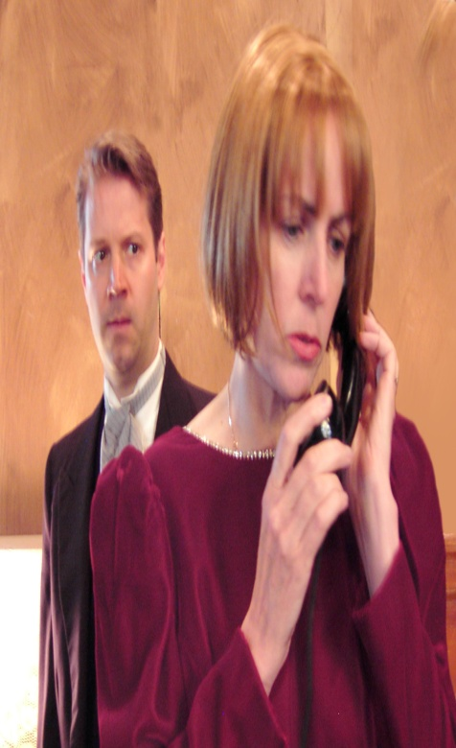
Interpersonal Attraction- Jealousy
Jealousy; emotion triggered when we perceive a threat by a rival to a valued relationship.
Reaction to perceived threat to the continuity or quality of a relationship.
Two types of threats; loss of partner & self-esteem
More likely to be jealous are people who are
    Highly dependent
    Have few alternative relationships
    More insecure
Sex Differences;
- Men get more jealous of sexual infidelity
(“paternity certainty” threatened)
- Women get more jealous of emotional infidelity
(Fear of loss of resource support for rearing offspring)

