Slide 1
Chapter 7
Social Influence
Conformity
Compliance
Obedience to Authority
Taylor, Copyright 2006, Prentice Hall

Slide 2
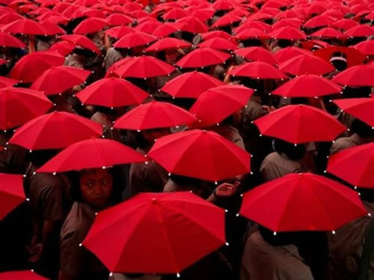
Social Influence
How an ind.’s beh. is influenced by
other people & groups?
Three types of social influence;
Conformity
- Voluntarily performing an act bec. others also do it.
Compliance
- Doing what we are asked to do even if we prefer not to
Obedience to Authority
- Complying with a person or group perceived to be a legitimate authority.

Slide 3
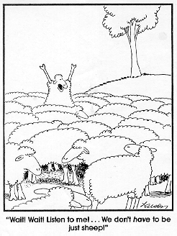
Social Influence - Conformity
Conformity
Changing one’s beliefs or behavior to be consistent with group standards
On one hand we need to go along to get along ( acceptance & group harmony)
On the other hand, valuing individualism & worrying that people can be pressured to go against their personal beliefs.
When is conformity a social is a social good & when conformity is harmful?

Slide 4
Social Influence - Conformity
Two important studies; The Sherif’s studies & The Ash’s Studies
A Guess in the Dark: Sherif’s Autokinetic Effect Study
Part.s sat in a darkened room & watched a single point of light.
Participants estimated the apparent
(but illusory) movement of a light.
When alone, estimates varied from 1-2
inches to 800 feet (ambigous situation).
In a series of experiements Sherif put part.s
in groups of 2 or 3.
Each participant gave his response in loud &
over time part.s’ estimates converged.
The effect of group influence persisted
when individuals were alone again.
Demonstrated the emergence of a group norm (standard for judging the light.

Slide 5
Social Influence - Conformity
A Guess in the Dark: Sherif’s Autokinetic Effect Study
In a variation of the study, Sherif examined whether he could
influence part.s’ conformity.
Part.s made their estimates in two-person group
(1-real subject; 1-confederate)
Confederate deliberatly made estimates lower &
higher than the real subject.
Real part. began to give estimates more & more
similar to the confederate
In uncertain & ambigous situations, people tend to conform to norm established by a consistent peer.
Ex: a student who transfers to a new school midyear, adopts the norms of dress & beh. already established by other students in the class.

Slide 6
Social Influence - Conformity
A Guess in the Dark: Sherif’s Autokinetic Effect Study
In a variation of the study, Sherif examined whether he could
influence part.s’ conformity.
Part.s made their estimates in two-person group
(1-real subject; 1-confederate)
Confederate deliberatly made estimates lower &
higher than the real subject.
Real part. began to give estimates more & more
similar to the confederate
In uncertain & ambigous situations, people tend to conform to norm established by a consistent peer.
Ex: a student who transfers to a new school midyear, adopts the norms of dress & beh. already established by other students in the class.

Slide 7
Social Influence - Conformity
As Plain As Day: The Ash Studies
Asch Line Judgment Study
Which line on the right best resembles the one on the left?

Slide 8
Social Influence - Conformity
As Plain As Day: The Ash Studies
Ash wondered whether conformity occurs only in ambigous situations or people also confirm in clear situations, too?
Part.s asked to choose the on the second card that was the most similar in length to the standard line.
Part.s asked to choose the on the second card that was the most similar in length to the standard line.
Part.s answered loud , Task was easy & no disagreement occured.
In other trials, however, the first four subjects gave the same obviously wrong answer, the 5th one disturbed, gave the same wrong answer even though he knew it was wrong. (35% of the time wrong answer was given)
In many cases, ind.s believe that their private judgements are correct but when asked to respond publicly they conform to the group& give the wrong answer.

Slide 9
Social Influence – Culture & Conformity
To understand conformity, one must understand the cultural context.
Individualistic cultures; emphasize freedom and independence, so “conforming” means loss of control.
Neg. aspects of conformity are emphasized.
Conformity as a threat to uniqueness of the ind.
Collectivist cultures ; emphasize ties to the social group, so “conforming” means maturity and inner strength.
Concerned with obedience, proper beh., respect for group traditions.
Conformity not as a group pressure; fulfilling one’s moral obligations , responsibility of the person
Desire for independence- selfish & immature
Meta-analysis of 133 cross-cultural confirmity studies showed more conformity among people from collectivist societies than individualist societies (Bond & Smith, 1996)

Slide 10
Social Influence: Conformity
Why do people conform?
Informational Influence:
The Desire to Be Right
Conforming bec. the beh.s of others provides useful info.
Ex: An American tourist trying to figure out how to buy a ticket for the subway in Paris (observe the beh.s of Parisians & conform to their beh.s, so succeeds to travel with the subway)
How well the the group is informed? How confident we are in making our independent judgments?
Trust in the group affects conformity.
Task difficulty affects conformity.
Affects both public behavior & private beliefs.

Slide 11
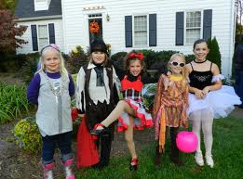
Social Influence: Conformity
Why do people conform?
Normative Influence:
The Desire to Be Liked
Conforming to be accepted and to avoid rejection from others leads us to conform.
Avoid being ridiculated or rejected (gain social acceptance / maintain standing in a group)
Ex: Teenagers dress like their friends to fit into a group & feel accepted.
Generally changes public behavior but not private beliefs.

Slide 12
Social Influence: Conformity
When do people conform?
People are more likely to conform in some situations than in others.
Factors affecting conformity;
Group Size
Group Unanimity.
Commitment to the Group
The Desire for Individuation

Slide 13
Social Influence: Conformity
Group Size: The larger the group, the more conformity up to a point.
Ash (1955), varied the size of the majority;
He found that 2 people produced more conformity pressure than 1, 3 a lot than 2.
However, increasing the size of the group past 4 did not lead to a significant increase.
Greater the size of majority- perceived as more trustworthy.
Group Unanimity: When the majority is unanimous, great pressure to conform.
When the group is not united; conformity sig.ly decreases.
Even one dissenter dramatically drops conformity.
The fact that someone disagrees with the group indicates there is a room for doubt (majority may be wrong)

Slide 14
Social Influence: Conformity
Commitment to the Group: Strength of the bonds btw. each ind. & the group
Greater the commitment ; greater the pressure to confirm.
Commitment; all the forces (both + & - ) that act to keep a person in a rel. or group
+ Forces; liking the group members, believing that group accomplishes important goals, benefits of belonging to the group
- Forces; few alternatives, making investment to the group
Desire for Individuation: Person’s willingness to do things that make him/her stand out (that differentiate him/her from other people)
Some people are more comfortable with blending with the group; some people look for distinctiveness.
High individuation people- distinctive ways of clothing, unique possesions, use distinctive nicknames.
High individuation people- less compliant, more critical & less polite.

Slide 15
Social Influence: Conformity
Minority Influence:
Influence that members of a minority
have over the majority in a group.
Sometimes a foreceful minority with a
new idea or a unique perspective can change the position of majority.
Studies of Moscovici (1985);
Majority were real subjects, minority were confederates.
Part.s asked rate color of slides; all slides are blue w/variation
In control groups (no confederates)- described all slides green
In experimental groups, about a third of participants reported that at least one slide was green.
The minority view had a noticable effect on the naive majority.

Slide 16
Social Influence: Conformity
To be effective, a minority must be;
Consistent in its Position: There must be consistency over time & agreement among the members of the minority.
(signifies minorities confidence & certainity).
Not Rigid but Flexible: If minority perceived as inflexible, rigid, uncompromising & dogmatic- less likely to change the views of the majority.
If minority appear flexible & compromising, likely to be perceived as less extreme, more cooperative &reasonable- more likely to change to views of majority.
Otherwise Similar to Majority: Minority should be similar to majority group in most respects except for the particular attitude in question.
Ex: A member of Republican party who tries to convince other Republicans will be more successful than a member of Democratic Party who tries to convince Rebuplicans.

Slide 17
Social Influence: Compliance
Compliance:
One of the basic ways people influence each other is directly asking them to do stg.
Ex: drive me to airport, lend me money, don’t smoke at home
Compliance; doing what we are asked to do even if we prefer not to do (responding to a request)
Sometimes we comply with requests seemingly no reason at all.
Mindless Conformity: complying with the request even when there is no logical justification with the request.
Ex: Langer (1978): A “placebo reason” (“Can I use the copier now because I have to make copies?”) increases compliance over no reason, and almost as much as a real reason (“because I’m in a rush”).
Response is made without thinking (about of habit), when someone asks for stg & gives a reason- you go along.

Slide 18
Social Influence: Compliance
People can influence each other in a variety of ways.
Raven et al. (1959) identified Six Bases of Social Power:
Rewards
Coercion
Expertise
Information
Referent Power
Legitimate Authority (Power of Helplessness)

Slide 19
Social Influence: Compliance
Rewards: Ability to provide or promise + outcomes for the person.
- Can be personal (e.g., a friendly smile) or
impersonal (e.g., money)
Ex: If you brush your teeth, I’ll take you to cinema
Coercion: Ability to provide – outcomes for the person.
- Can range from physical force to punishment or disapproval.
Ex: If you don’t brush your teeth, I will not allow you to watch tv.
Expertise: Special knowledge, training & skills
- We follow the advices of experts bec. we belive their knowledge will help us to achieve our personal goals.
Ex: The dentist tells you to brush your teeth twice a day.
Expertise
Information
Referent Power
Legitimate Authority
Power of Helplessness

Slide 20
Social Influence: Compliance
Information: Influencing people by giving info. or logical arguments.
- Persuasive content of the message (Influencer not an expert)
Ex: If you don’t bursh your teeth, you may have cavities that will hurt
Referent Power: Social influence based on identification.
- When you identify with the group or foster a rel. with a person.
- Idnetifying with or wanting to be like another person or group
- We may voluntarily copy their beh.s (conformity) or do what they ask (compliance)
Ex: Your big brother Sam always brushes his teeth
Legitimate Authority: One person has the right or authority to ask another person to act in a certain way.
- Social norms or legal laws permit those in authority to make request..
Ex: I am your mother & I am telling you to brush your teeth.

Slide 21
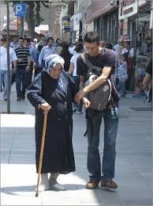
Social Influence: Compliance
Legitimate Authority:
Power of Helplessness: Special case of legitimate authority.
Ex: Child asks his mother for help taking off his snow boots
A blind person asks you to read the price of a product in the market
An eldery person asks for help for crossing the road.
. - The person asking for help is in a powerless or
helpless position.
- People are likely to comply with the request bec. of
norm of social responsibility (norm dictating that that we should help others who depend on us) / social obl obligation
Caution (!): People who constantly claim to be
helpless may come to see themselves as
incompetent.

Slide 22
Social Influence: Compliance
Specific Compliance Techniques: Specific Techniques people use to gain compliance.
Foot-in-the-Door Technique: First make a small request, then a large one.
- Once someone has agreed to the small action, she/he more likely to agree to a larger request.
- People desire to view themselves consistent / people who agree to a small request become involved & committed to the issue.
Door-in-the-Face Technique: First make an unreasonably large request, then a smaller one.
Ex: People are asked to volunteer a study & asked to give a huge amount of time; when they refuse researcher says perhaps they may agree to a much smaller commitment of time.
- When you reduce demands the other person thinks you are compromising & the amount seems smaller.

Slide 23
Social Influence: Compliance
Specific Compliance Techniques: Specific Techniques people use to gain compliance.
The Law Ball Technique: First make a reasonable request; then reveal further costs
- Giving incomplete info. & then, later tell the whole story.
Ex: Researcher calls you to participate a study. When you agree, he/she tells you that the study will be scheduled on Saturday at 7.00 A.M.
That’s-Not-All Technique: First make a large request, then offer a bonus or discount.
- Make a deal & then improve the offer.
Ex: Salesperson desribes a new microwave to the customer & quotes the price. While customer is thinking; sales person says ‘’That is not all. Today we have a special discount. If you get the oven, we’ll give you a five- microwave dishes for free’’.

Slide 24
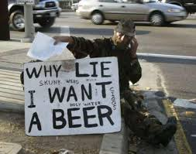
Social Influence: Compliance
Specific Compliance Techniques: Specific Techniques people use to gain compliance.
The Pique Technique: Make an unusual request to disrupt target’s mindless refusal script
- Capture the target’s interest & increase the chances of compliance with the request.

Slide 25
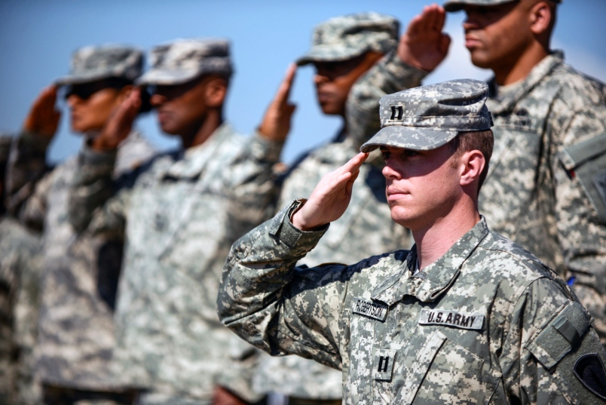
Social Influence: Obedience
Obedience to Authority: One of the six bases of social power.
In some social situations, we perceive one person/group as having the legitimate authority to influence beh.
Ex: goverment has right to ask for taxes; generals have right to ask soldiers to obey their rules etc…
Obedience; based on the belief that authorities have the right to make requests.
People are more likely to obey;
If they receive benefits from belonging
to the group
If people feel fairly treated
If people trust authorities’ motives
If people identify with the group

Slide 26
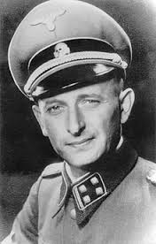
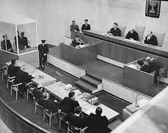
Social Influence: Obedience
Crimes of Obedience
What happens when the demands of authorities conflict with our beliefs & values?
Crimes of obedience (Kelman & Hamilton, 1989): when the demands of authorities are immoral or illegal.
Ex: soldiers obey orders to torture civilians
The “Eichmann defense”; Adolph Eichmann’s claim that he was “just following orders” when he supervised the murder of 6 million Jews in Nazi Germany
Less extreme forms of obedience
are more commonplace.
Ex: executives ask their employees to
violate a law; a political leader asking
for unethical campaign practices.

Slide 27
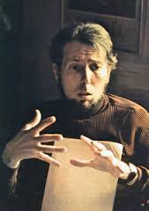
Social Influence: Obedience
The Milgram Experiments
The annihilation of the Jewish could not have happened without cooperation of thousands of ordinary citizens.
Why did they comply with the Nazi regime?
Stanley Milgram (1963-1974); designed a series
of laboratory experiments to understand obedience.
Participants were assigned to serve as the “Teacher” & administer shocks to the “Learner” (a confederate).
The teacher sat in front of a large shock machine
Shock levels ranged from 15 to 450 mv.
The learner was put in a chair in another room.
Milgram was interested in the point at which people would disobey the experimenter in the face of the learner’s protests.

Slide 28
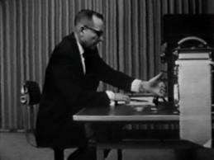
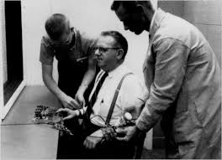
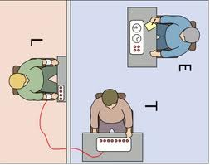
Social Influence: Obedience
The Milgram Experiments

Slide 29
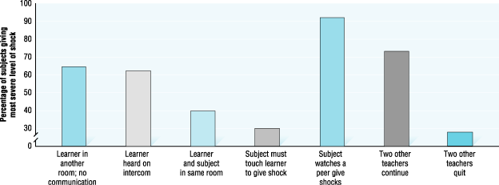
Social Influence: Obedience
The Milgram Experiments
In a series of 18 experiments, Milgram identified the conditions that increase or decrease subjects’ obedience.
Situations that made ind.s feel more responsible & that emphasized the suffering of the victim reduced obedience.
Variations decreasing obedience
Increasing closeness of learner
Increasing distance of experimenter
Two other teachers quit
Variations increasing obedience
Watching a peer give shocks
Two other teachers continue
Presence of the experimenter

Slide 30
Social Influence: Obedience
The Milgram Experiments
The Milgram experiments illustrate the “normality” or “banality” of evil and the power of the social situation.
People sometimes do resist pressures to obey;
When victims’ suffering is salient
When person feels responsible for their actions
When others model disobedience
When people are encouraged to question authority
Milgram’s research started a debate about the ethics of psychological research.
Some researchers criticized Milgram for exposing participants to psychological distress, embarrassment & loss of dignity.

