Slide 1
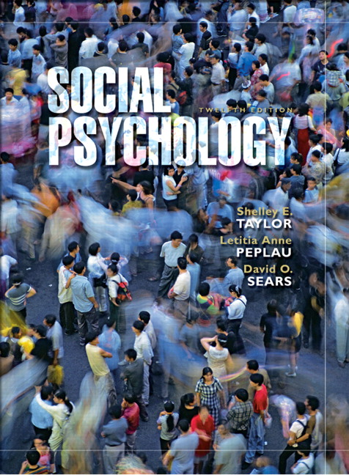
Chapter 6
Prejudice
Learning Prejudice
Motives for Prejudice
Cognitive Bases of Prejudice
The Changing Face of Prejudice
Reducing Prejudice
Taylor, Copyright 2006, Prentice Hall

Slide 2
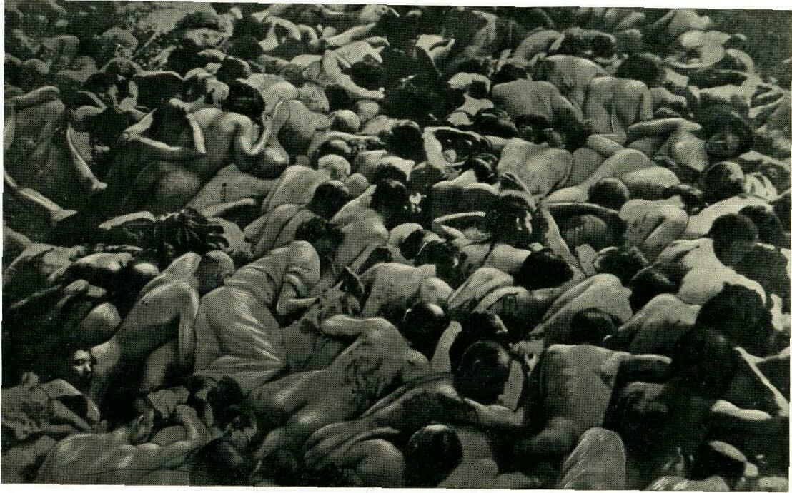
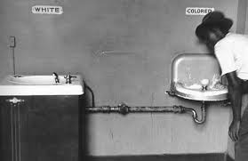
Prejudice
Prejudice; one of the most destructive aspect of human behavior
More than 6 million Jews were murdered by Nazis in 1940s
In U.S. Africans were brought to America as slaves & treated as property.
Gay & lesbians have been subject to intense prejudice from the heterosexual majority.
Overwieghted & elderly people are often targets of prejudice.

Slide 3
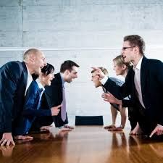
Prejudice
Components of Group Antagonism
Group Antagonism; exhibited when members of one group (in-group), display neg. att.s & beh.s toward members of another group (out-group).
In-Group; the group which an ind. belongs
Out-Group; any group other than the in-group.
Group antagonism has 3 elements;
Stereotypes; cognitive
(beliefs about typical caharacteristics of group members)
Prejudice; affective
( neg. feelings toward a target group & its members)
Dsicrimination; behavioral
(behavior that disadvantages ind.s simply bec. of their group membership

Slide 4
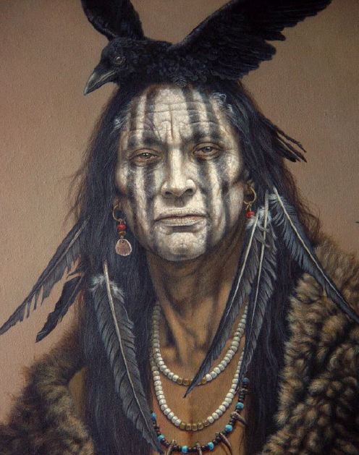
Components of Group Antagonism Stereotypes
Stereotypes; cognitive beliefs about the attributes shared by people in a particular group or social category.
May involve personality traits
- Native Americans; as dirty cruel &
warlike savages
Other types of attributes
- African Americans ; as having
lower educational & income levels.
Are stereotypes accurate?
- There is a grain of truth about stereotypes.
- Yet , they contain much inaccuracy; they are overgeneralizations about many quite different ind.s
- Stereotypes usually overemphasize certain attributes & underestimate variability within a group

Slide 5
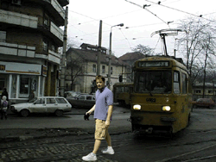
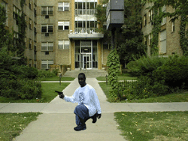
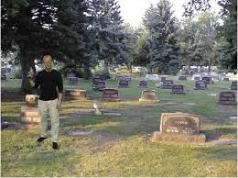
Components of Group Antagonism Stereotypes
Study by Correll et al., 2002; examined the effects of racial stereotype of black criminality on beh. in a video game.
- Part.s were shown to both black & white targets, and asked to shoot armed targets & not to shoot unarmed targets.
- Decisions about shooting the armed target were made more quickly if the target was African American & decisions about not shooting the unarmed target were made more quickly if the target was White.
Who would you shoot?

Slide 6
Components of Group Antagonism Stereotypes
Research also examined the effects of stereotyping on their targets;
Stereotype as Self-Fulfilling Prophecy; it can produce stereo-type confirming beh. on the part of the out-group members.
Ex: Older Americans who accept the setereotype that memory declines with the age are more likely to show memory declines than those who reject the stereotype ( they begin to doubt their own memory & lose self-confidence)
Stereotype Threat; threat felt when stereotypes is salient to targets of neg. stereotypes.
Stereotype threat may provide a plausible explanation for one’s own performance.
Ex: Women are often stereotyped as being less good at maths than men.
High-achieving females performed sig.ly worse than did males on a math test when the stereotype about their math ability made salient.

Slide 7
Components of Group Antagonism Prejudice
Prejudice; neg. feelings or attitudes about a group or about a single ind. based on the person’s group membership.
Generally people are more likely to evaluate the attributes of out-groups than those members of their own group.
Ethnocentrism; the belief that the in-group is the center of the social world & superior to out-groups.
The effects of prejudice are also destructive & wide-ranging.
Ex: Merely sitting next to a person from a stigmatized group is enough to cretae harm.
Male job applicants were more likely to be evaluated neg.ly if they were simply sitting next to an obese woman; even if they were thought not to know the woman or when pos. info. was presented to her.
Most of the time, sterotypes & prejudice tend to go together.
Highly prejudiced people are the most likely to recognize conventional stereotypes.
Still, possible for people to be familiar with common cultural stereotypes & remain unprejudiced.

Slide 8
Components of Group Antagonism Discrimination
Discrimination; neg. beh.s toward ind.s based on their group membership.
In 1942, U.S. Sent 120.000 Japanese to internment camps & forced them to abandon most of their possessions.
The quotas in college admissions limited the number of Jewish & Asian American students before 1960s.
People discriminate against a disliked group by refusing its members access to desired resources (intent to harm is critical factor)
Discrimination may be blatant or subtle; both are damaging
Ex: Exposure to sexist humor can increase tolerance of sex discrimination (Ford, 2000).
Discrimination disguised as something else leads to attributional ambiguity.

Slide 9
Components of Group Antagonism Discrimination
Attributional ambiguity; uncertainty about whether one’s failures are due to discrimination or to one’s own inadequate performance.
A person turned down for promotion can not tell whether it was bec. her performance was inadequate or bec. she was discriminated against.
The damaging effects of such neg. evaluations can be lessened if the victim is able to attribute them to discrimination. (threat to self-esteem is reduced)
Yet, it can produce a dilemma for the victim of discrimination; the person can be perceived as a troublemaker or complainer & leads to still further criticism to oneself.
Discrimination & prejudice are not always consistent (LaPiere’s study)

Slide 10
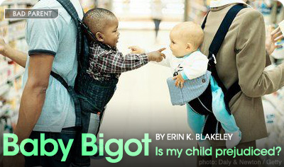
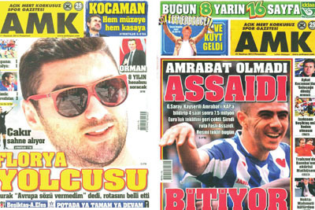
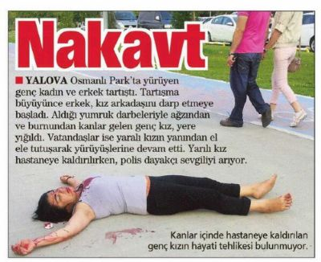
Prejudice- Learning Prejudice
People learn prejudice in the same way people learn other attitudes & values.
Socialization
Media

Slide 11
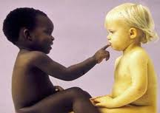
Prejudice- Learning Prejudice
Socialization:
Children are not born with stereotypes & prejudice.
They learn them from their family,
peers, media & society around them.
It can take place through any of the
standard social learning mechanisms;
Children may imitate the prejudices of adults & friends
They may be pos.ly reinforced for using derogatory ethnic rumors
They may learn to associate minority groups with poverty, crime, dirtiness etc..
At the age 4 or 5, most white children differentiate btw. blacks & whites, and aware of the prevailing norms about race.
Children’s recognition of less salient ethnic groups (Latinos & Asians) tend to delay a few years, but by age 7, they also show signs of prejudice against them as well.

Slide 12
Prejudice- Learning Prejudice
Socialization:
Parents & peers are most responsible for passing on these social norms but other vehicles are also available (e.g. media, children’s books)
Children’s early experiences are curicial (prejudices toward highly salient groups do not change later in an ind.’s life.
Whites brought up in the South are still more prejudiced than those brought up in the North, regardless of where they live as adults.
The norms of one’s early environment have stronger effects on one’s adult level of prejudice than later experiences.
In adulthood; continuing reinforcement from like-minded people in one’s own group helps maintain conformity to such norms.
The majorty views of members of our own group play a powerful role in reinforcing our stereotypes & in protecting them from change.

Slide 13
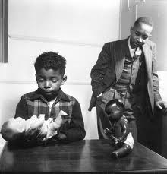
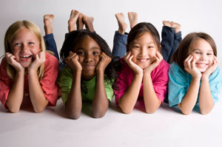
Prejudice- Learning Prejudice
Socialization:
An example of how children learn & internalize prejudice;
https://www.youtube.com/watch?v=tkpUyB2xgTM (DOLL TEST)

Slide 14
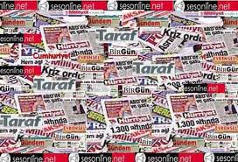
Prejudice- Learning Prejudice
The Media :
Media represents another potential source of social learning
Until last decades, racial minorities were largely invisible in the mass media
Media coverage of any given group is likely to reflect society’s current stereotypes of that group.
Ex: Although Latinos make up 13% of the American population, they made up only 4% of the regular characters on prime-time television.
Latino characters depicted as illegal immigrants, drug runners or gangbangers
Great majority of the pictures of poor people presented in the media are of non-working working blacks.
Media tends to ignore the very large number of number of white poor & working poor.

Slide 15
Prejudice- Learning Prejudice
The Media :
Similarly, fewer than 1% of the cartoons in The New Yorker showed blacks even in 1980s & those appeared were related to stereotypical roles such as cleaning ladies or workers.
Sometimes media do rise above simple stereotypical images.
Ex: Much of public’s info. About AIDS has come from media & helped to reduce misinformation the epidemic & increase towards its victims.
Yet anti-gay prejudice in general public
interferes with reception of accurate
media info. about AIDS.

Slide 16
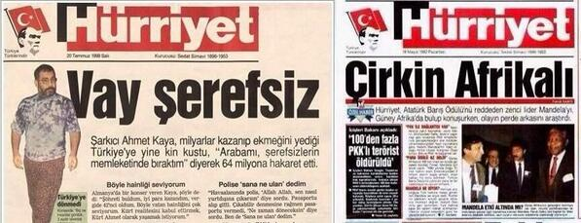
Prejudice- Learning Prejudice
The Media :
The mass media are products of their own society & tend to reflect its stereotypes & prejudices.
Even when the media present info. That would dispel inaccurate stereotypes, the audience’s prejudices may interfere with its reception.

Slide 17
Prejudice- Motives for Prejudice
How prejudice satisfy the needs of individuals?
Motivational Theories that focus on the motives of inds. & on the incentives that induce ind.s to adopt prejudices attitudes.
Psychodinamic Approaches
(Authoritarian Personality, Displaced Agression)
Intergroup Competition
( Realistic Group Conflict Theory, Sense of Group Position,
Social Dominance Theory)

Slide 18
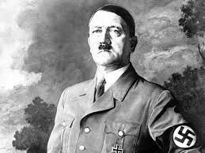
Prejudice- Motives for Prejudice
Psychodynamic Approaches
Authoritarian Personality;
Analyzes prejudice as an outgrowth
of the dynamics of an ind.’s personality
(personality disorder)
Authoritarian personality characterized as;
exaggerated submission to authority
extereme levels of conformity to conventional standards of behavior
self-righteous hositility
punitiveness toward deviants & members of minority groups
Authoritarian personalities were also said to originate in abusive & rigid treatment during childhood.

Slide 19
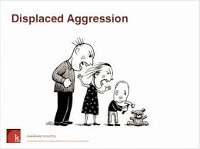
Prejudice- Motives for Prejudice
Psychodynamic Approaches
Displaced Aggression
Prejudice as an outcome of displaced
agression
People who are angry or frustrated normally try to express their agression toward the source of their unhappiness.
Yet, if the source cannot be attacked (bec. of fear or unavailability), aggression may be displayed toward another target.
Ex: People who lose their jobs during economic repression looked for a scapegoat. Lynching of African Americans increased in bad economic times (Hovland & Sears, 1940)

Slide 20
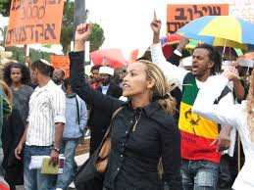
Prejudice- Motives for Prejudice
Intergroup Competition:
Prejudice stems from intergroup competition
Society composed of groups that differ in social power, economic status, social status & other desirable attributes.
Dominant groups are motivated to maintain their previleged positions whereas subordinate groups motivated to reduce inequality.
Competition produces intergroup conflict & leads to prejudice

Slide 21
Prejudice- Motives for Prejudice
Intergroup Competition:
Realistic Conflict Theory; prejudice is an inevitable consequence of real conflicts of interest (resources & power) between groups
Ex: Prejudice may stem from competetion btw. blacks & whites for blue collor jobs.
Related theory; Relative Deprivation Theory
Hostility stems from the perception of relative deprivation, rather than from absolute levels of deprivation.
People may be discontented due to the belief that one’s group is faring more poorly than others.
Ex: Relative eprivation played role in riots in black ghettos in 1960s. They believed their economic situation was much worse than that of whites.

Slide 22
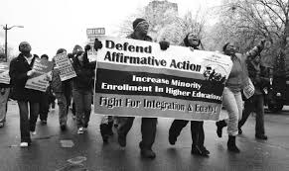
Prejudice- Motives for Prejudice
Intergroup Competition:
Sense of Group Position; Members of dominant group believe that their advantaged position is deserved & subordinate groups are threatening to take these privileges away.
Belief in the superiority of the dominant group
Perceiving subordinate groups as alien, different & non-human
Ex: Whites opposition to affirmative actions which provide special help to blacks.

Slide 23
Prejudice- Motives for Prejudice
Intergroup Competition:
Social Dominance Theory; Societies are organized in group hierarchies
People high in social dominance orientation- supporters of a rigidly hierarchical society
Pople low in social dominance orientation- promote equality (e.g. ,left wing political activists)
How dominant groups try to maintain their privileged status?
Not generally by physical force !
Benevolent Paternalism; paternalism by the dominant group & deference by the subordinate group (rel. btw. two groups is good as long as subordinates stay in their place
Ideology; Dominant groups create legitimizing myths in order to justify the inequalities.

Slide 24
Prejudice- Cognitive Bases of Prejudice
Seemingly harmless cognitive biases can produce stereotyping, prejudice even in the absence of competition for resources.
Categorization
The process by which we percieve people as members of groups or categories rather than distinct ind.s
(whether a person is black or white, man or woman?)
People categorize others into groups on the basis of perceptually salient characteristics (e.g., race, gender, language)
Social norms provide a basis for categorization based on other attributes (e.g., religion)
Categorization into social groups is important bec. it is often affectively loaded (category label has an evaluation associated with it.
Ex: Fat people (strong neg.), large people (fairly neutral)

Slide 25
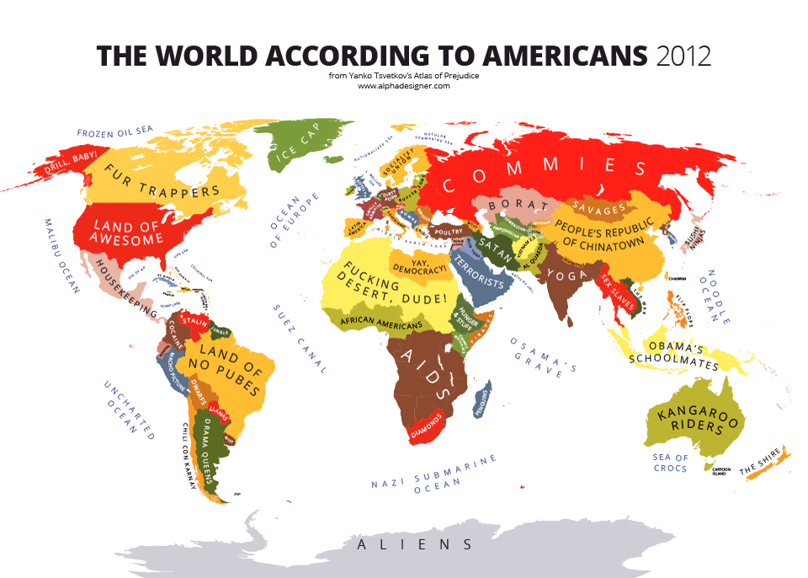
Prejudice- Cognitive Bases of Prejudice

Slide 26
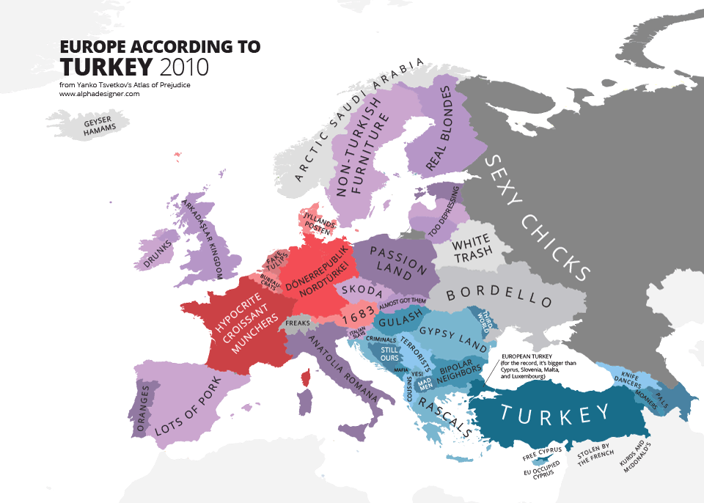
Prejudice- Cognitive Bases of Prejudice

Slide 27
Prejudice- Cognitive Bases of Prejudice
Category-Based Processing occurs quickly, unconsciously & involuntarily
Priming a stereotype makes it salient & increases its influence over ind.’s thinking.
Ex: In a study (Slusher & Anderson, 1987)- subjects were told to imagine a situation about agressive lawyers. Results revealed that subjects believed those stereotypes more than did subject who were not asked to imagine them.
Category-based processing is influenced by the accessibility of categories (the more accessible the category is, the more likely to be used)
Ambiguous or inadequate information is especially likely to lead people to rely on stereotypes

Slide 28
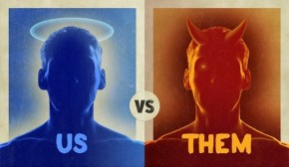
Prejudice- Social Identity Theory
Social Identity is a crucial element in the cognitive approach
Social Identity; part of self-concept derived from membership in one (or more) social groups.
In-group/ outgroup
Categorization leads to grouping people into us (in-group) & them (out-group).
In-group Favoritism; tendency to give more favorable evaluations & greater rewards to member’s of one’s in-group.
In-group favoritism occurs even there are no selfish gains & when there is no pos. interaction with the in-group.

Slide 29
Prejudice- Social Identity Theory
Minimal Group Pradigm (Tajfel, 1969); method for investigating the minimal conditions required for discrimination to occur between groups.
Arbitrary & virtually meaningless distinctions between groups (e.g. , preferences for paintings or the color of their shirts) can trigger a tendency to favor one's own group at the expense of others.
Group-Serving Biases; making internal attributions for in-group’s successes & external attributions for in-group’s failures.
Group members make fav. attributions for the performance of in-group members & unfav. attributions for performance of out-group members.
Ex: men give external attributions when women succeed in maths, internal attributions for women’s failures in maths.

Slide 30
Prejudice- Social Identity Theory
The Assumed-Similarity Effect: In-group members seen as more similar to the self than out-group members even when groups are distinguished arbitrarily or randomly
Ex: Allen & Wilder (1979)- randomly assigned part.s into groups ostensibily on the basis of artistic preference. Part.s rated in-group members as more similar than out-group members even on matters unrelated to art.
The Out-group Homogeneity Effect: Tendency to see out-group as quite homogenous in terms of traits, personality etc.
“They are all alike, while we are diverse.”
Perceive members of in-group as being more complex (personalities seen as more multidimensional, variable & rich).
Ex: Young people see the young as more complex than elderly (vice versa)
May also stem from ignorance & having less experience with outgroup members.

Slide 31
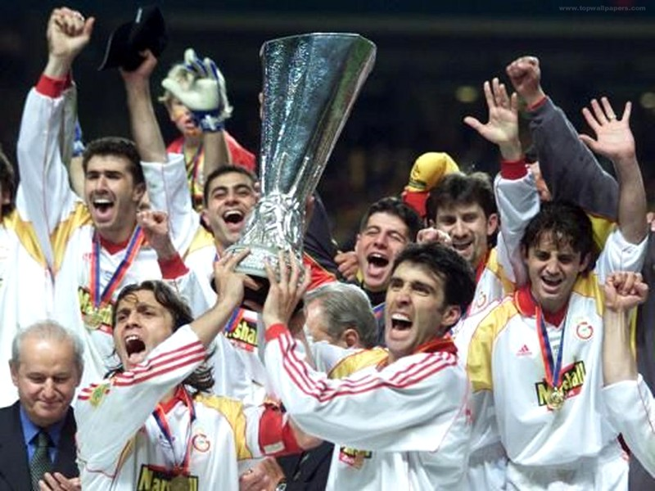
Prejudice- Social Identity Theory
Why in-group & out-group effects occur?
Evolutionary Approach- in order to increase fitness (reproduce genes), hunter gatherer tribes began favoring relatives & engaging in hostalities to other tribes.
In-group favoritism & outgroup antagonism could protect limited sources & increase the survival of one’s own family.
Acc. to Tajfel (1982);
People derive a sense of self-esteem from social identity
Self concepts partly depend on how they evaluate in-group relative to our groups.
Self-esteem increases, if the person belong to a superior belongs to superior in-group, it decreases decreases if the person belongs to an an inferior in-group.

Slide 32
Prejudice- Social Identity Theory
In-group favoritism enhances self-esteem.
Low self-esteem doesn’t foster in-group favoritism.
People with low self-esteem are more prejudiced against out-groups, but they are negative about the in-group as well.
(In-group identification may be stronger among people with high-self esteem).
Distinction btw. private & collective self-esteem;
Collective self-esteem depends on how your group does, private self-esteem depends ind.’s performance.
Ex: If you receive a pay rise, you feel better
(private self esteem rises)
If your college’s football team wins
(collective self esteem rises, private self-esteem does not change)

Slide 33
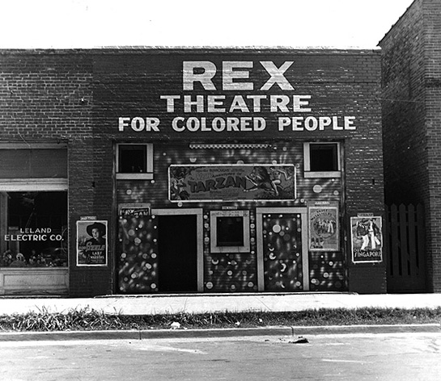
Prejudice- Changing Face of Prejudice
Changes since the earliest psychosocial studies of 1940s.
(Hitler, civil rights movement, women rights)
Does this mean there is no prejudice now?
Old-fashioned racism declined
- innate superiority of race
- racial segregration in public areas
- discrimination of blacks in areas as
of employment & higher education
However, there is still resistance to full equality.
Negative stereotypes persist
Many Whites give only weak support to government action to promote racial equality

Slide 34
Prejudice- Changing Face of Prejudice
Is the apparent decline in racism real or illusory?
Few differences between responses to face-to-face interviews and private, anonymous survey questionnaires
Most social scientists believe the decline is real.
Some believe that old-fashioned racism has been replaced by symbolic & aversive racism
Symbolic Racism;
Discrimination is no longer a major obstacle
Blacks do not make enough effort to help themselves
Demands for special treatment by Blacks are unwarranted (and resented)
Symbolic racism is correlated with old-fashioned prejudice & whites’ opposition to black political leaders.

Slide 35
Prejudice- Changing Face of Prejudice
Aversive Racism; support for racial equality mixed with negative feelings towards Blacks
Leads Whites to avoid Blacks because they feel ashamed of having negative feelings and allows them to protect their self-image as unprejudiced.
May allow Whites to discriminate against Blacks when there is a plausible non-racist justification for their actions.
In egaliterian contexts;
(e.g; grading term papers, evaluating job
applicants, defendants in trial)- there is an
equal treatment, or sometimes even slight
bias in favor of African Americans.
In ambigous contexts;
- Whites tend to sit further away, use less friendly voice tones, make less eye contact & terminate interactions more quickly.

Slide 36
Prejudice- Changing Face of Prejudice
Implicit Stereotypes
Reflect well-learned sets of associations that can be automatically activated, & so spontenous, uncontrollable, unintentional without awareness.
Explicit measures of prejudice may correlate with deliberative judgments;
e.g.; support for black leaders, evaluations of a black interview, rating’s of a black defendant
Implicit measures may correlate with spontaneous, involuntary responses.
e.g.; physical proximity, blinking, avoidance of eye contact or friendliness.

Slide 37
Prejudice- Reducing Prejudice
How can prejudice be reduced?
Obvious step- redistributing jobs, income, wealth & medical care, good housing
However, there will be never enough resources to satisfy everyone.
Other ways;
Socialization
Intergroup contact
Recategorization

Slide 38
Prejudice- Reducing Prejudice
Socialization:
Prejudice learned fairly in early life, tends to be stable over many years.
Much change is happening spontaneously as groups change (more prejudiced elderly dying & younger people growing up with less prejudice), as targets change (they no longer fit older stereotypes) and levels of education rise.
Still, such spontenous reductions in prejudice have not eliminated it.
Intervation programs, direct training in negating stereotypes;
Ability to take the perspective of other
Imagining how other person feels (empathy)
Imagining a counter-sterotypic ind.
shown to reduce stereotypes (Galinsky & Moskovitz, 2000)

Slide 39
Prejudice- Reducing Prejudice
Intergroup Contact:
Black people and White people are still quite segregated in the U.S (Blacks continue to live in predominantly black neighbourhoods)
Contact btw. groups may help to reduce erroneous stereotypes due to ignorance
Ex: When American Army allowed African American voleenters to join military during WWII, stereotypes of American soldiers reduced.
Mere contact between groups will not necessarily reduce prejudice.
Gordon Allport’s Contact Theory (1954):
Cooperative interdependence (to solve a common problem)
Equal status
Sufficient frequency, duration, closeness
Institutional support

Slide 40
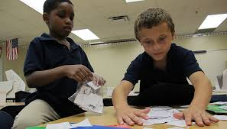
Prejudice- Reducing Prejudice
Intergroup Contact:
Aronson’s jigsaw technique (1998):
Children meet small multicultural group; each child is responsible for teaching the lesson but no-one can complete the assignment without the info. contributed by others.
decreased prejudice, increased self-esteem & academic performance.
However, many efforts at intergroup contact do not meet the conditions.

Slide 41
Prejudice- Reducing Prejudice
Recategorization:
Encouraging people to re-categorize members of the in-group & the out-group as members of a larger, more inclusive group may reduce prejudice.
Superordinate group
large & inclusive group categories defuse conflict among smaller groups
Ex: Football players praying together after a hard-fought game
Not German, Not American, Not Turkish- But Earthly Humanbeings
Cross-cutting categories
Ex: members of different churches who belong to the same soccer team
However, there will be always outgroups

