Slide 1
Chapter 10
Behavior in Groups
Basic Features of Groups
Group Performance
Group Decision Making
Leadership
Taylor, Copyright 2006, Prentice Hall

Slide 2
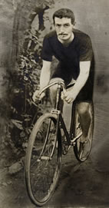
Behavior in Groups
How the mere presence of other people affects behavior?
The presence of others sometimes enhances & sometimes impairs an individual’s performance.
Social Facilitation: People sometimes perform better in the presence of others than when they are alone
The performance of simple tasks facilitated by the presence of an audience (or of others working on the same task).
Norman Triplett (1898): Racing cyclicts go faster
when racing with others than riding alone.
Social facilitation occurs:
Whether others are performing the same task, or
whether the others are merely observers
In many species others than humans (rats, cockroaches etc..)

Slide 3
Behavior in Groups
How the mere presence of other people affects behavior?
Social Inhibition: the presence of others inhibits a person’s performance
Performing more poorly when others are present than when alone.
-Why does the presence of others sometimes improve performance & other times diminish it?
Zajonc (1965); Being in the presence of others increases ind.’s drive & motivation
Increased arousal may lead to better or worse performance depending on the nature of task
If task simple (or well-learned); presence of others increases performance. (e.g; doing easy arithmetics, crossing out vowels)
If task is complex (or poorly learned); the presence of others decreases performance (e.g; memorizing new material, difficult aritmetic problems)

Slide 4
Behavior in Groups
How the mere presence of other people affects behavior?
Zajonc’ s(1965) Theory of Behavior in the Presence of Others:

Slide 5
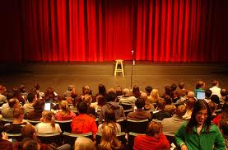
Behavior in Groups
Why does the presence of others motivate us?
Zajonc - Innate tendency for arousal in the presence of others
Evaluation Apprehension - we are concerned with how other people will evaluate us & we want to make a pos. impression.
Distraction- presence of others is distracting; on tasks that don’t require full attention; we compensate for distraction by trying harder.
Biopsychological- Presence of others evokes either challange or threat responses.
When ind.’s resources sufficient- challenge reaction occurs (efficient cardiovascular functioning) & when resources are not sufficient, threat reaction occurs

Slide 6
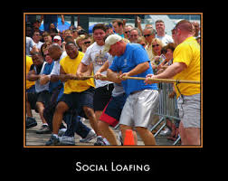
Behavior in Groups
Social facilitation & inhibition occur when a person’s performance is individually identifiable
Social Loafing: When an individual’s contribution to a collective activity cannot be evaluated, individuals often work less hard than they would alone.
Productivity loss in groups; deliberately exerting less effort to achieve a goal when working in a group.
Ringelmann (1882-1887): when 8 men who pull at a rope together achieve only 50% of the pulling power when measured individually.
More than 100 studies have
demonstrated the social loafing effect
on wide range of tasks
(e.g.; creating noise by cheering or clapping;
writing songs, evaluating job candidates)

Slide 7
Behavior in Groups
Acc. to Karau & Williams(1993)- Social loafing depends on;
How important the person believes his/her contribution is to group success ?
How much the person values group success / how much the person values the potential outcome of group success?
Reducing Social Loafing;
Make each person’s contribution identifiable
Provide rewards for high group productivity
Make task meaningful, complex, or interesting

Slide 8
Behavior in Groups
People sometimes work extra hard in order to compensate for unmotivated coworkers.
Social compensation: a person expends great effort to compensate for others in the group.
Two conditions of social compensation;
The person must believe that teammates are performing inadequately (or the person does not trust in group members)
The person must be concerned with the quality of the group product
Williams & Karau (1991); examined the rel. btw. personal effort & trusting one’s coworkers.
Students who scored high on interpersonal trust showed social loafing
Students who scored low on interpersonal trust showed social compensation.

Slide 9
Behavior in Groups
Social Impact Theory: How strong will be the influence of observers?
Three chracteristics of observers determine the strength of the influence;
Number - as the number of observers increases , their impact increases.
Ex: An actor should experience more stage fright when performing in front of 50 people than in front of 5 people
Strength (importance)- Power or importance of observers (status & age)
Ex: A student may feel worse about presenting his study to his/her teachers than to his/her friends
Immediacy- Closeness of the audience to the ind. in space & time.
Ex: An actor’s reaction will be stronger when he performed in front of live auidence than being taped for future viewing.

Slide 10
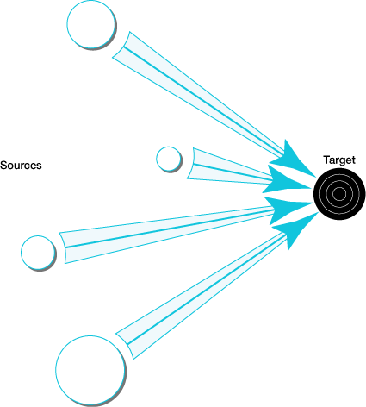
The impact of an audience on a target depends on the number of people present, the immediacy & strength of importance.
number of circles: The number of people present
nearness of the circles: the immediacy of the people
size of the circle. the strength or importance of the people

Slide 11
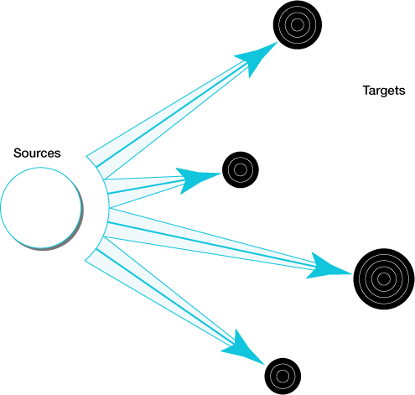
When each individual is only one of several targets of social influence, the impact of the audience (sources) on the target is lessened.
number of circles: The number of people present
nearness of the circles: the immediacy of the people
size of the circle. the strength or importance of the people

Slide 12
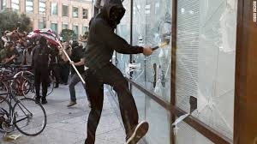
Behavior in Groups - Deindividuation
Sometimes people seem to lose themselves in a crowd & act differently from if they were alone.
Crowd’s behavior gets out of control (vandalism & acts of public nudity etc…)
Deindividuation (Postmes & Spears, 1998): may occur in crowded, anonymous situations when people lose a sense of responsibility for their own actions & feel free to express aggressive and sexual impulses.
Le Bon (1896): emotions of one person
spread throughout the group.
When a person does stg. everyone tends
to do it (Social Contagion)
Naturalistic example; children who were trick or treating in Halloween

Slide 13
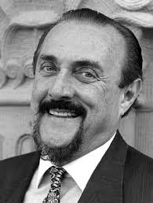
Behavior in Groups - Deindividuation
Zimbardo (1970) – demonstrated deindividuation in a lab. setting.
Had groups of four young women participated in the study (supposedly about emphatic responses to strangers)
Part.s asked to deliver electric shocks to another person.
Groups were either easily identifiable (name tags) or not (wore oversized lab coats, no name tag).
Unidentifiable groups gave twice as many shocks.
Deindividuation increases when individuals are anonymous & as group size increases.
Might create a special psychological state in which people are unaware of own values & beh.s (focus on group & situation)
Might heighten individual’s identification with the group & increase conformity.

Slide 14
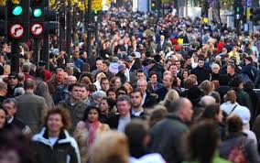
Behavior in Groups - Crowding
Crowding: The subjective feeling of having too little space.
The psychological state of discomfort & stress associated with wanting more space than is available.
Regardless of the amount of space we actually have;
(there are times when three is a crowd no matter how much space is available)
Distinction btw. subjective feelings of being crowded & objective measures of population density.
Social density ; the objective number of people in a given space.
High social density may or may not be experienced as unpleasant
Crowding is always unpleasant.

Slide 15
Behavior in Groups - Crowding
When do people experience of others as crowding?
Sensory Overload: Milgram (1970); when people exposed to too much stimulation, they experience sensory overload.
Overstimulation may lead to feelings of being crowded.
High stimulation people- high social density is not a problem & perceived as pleasant, exciting
Low stimulation people- high social density is distruptive & perceived as crowding.
Loss of Control: Baron & Rodin (1978); high social density can make people feel they have lost control over their actions.
People less able to control their environment, to move freely & to avoid undesirable contact.
Prevent maintaning privacy & problems coordination of activities

Slide 16
Behavior in Groups - Crowding
When do people experience of others as crowding?
Attributions: Causal attributions to the presence of other people
Crowding has two elements;
State of arousal
Attribution of arousal to the presence of other people
Less likely to experience crowded- when attribution is made to other things.
Ex: When subjects in high density conditions exposed to arousing tv shows (e.g.;violent, sexual) they feel less crowded .
Culture: Cultural differences in experience of crowding.
People from collectivist cultures are less likely to experience high social density as crowding.
However, the negative health effects of high social density occur regardless of culture (In both cultures; ind.s living in households with more people were more likely to experience psychological distress.)

Slide 17
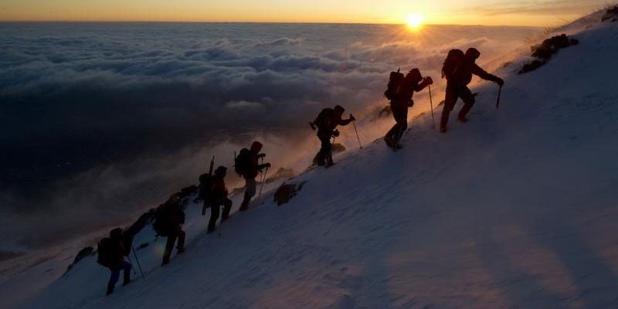
Behavior in Groups – Basic Features of Groups
How people interact & affect each other in small groups?
Group: A group involves multiple people
who are interdependent & have mutual
influence (interaction with) on each
other.
Typically have regular-face-to-face contact (but not always!)
increasing use of internet ( newsgroups, forums of discussion & interactive games
Different from a social category
All professional basketball players- not a group
Los Angelas Lakers basketball team- is a group

Slide 18
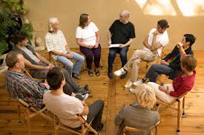
Behavior in Groups – Basic Features of Groups
Group Structure: When people are in a group, they develop patterns of beh., divide tasks, & adopt different roles.
Ex: Merei (1949)- only after 3- 4 meetings groups of young children established informal rules.
Group Structure; Patterns of behavior within a group.
Group structure has three elements:
Social norms
Social roles
Social status

Slide 19
Behavior in Groups – Basic Features of Groups
Social norms: shared rules & expectations about how group members should act.
Rules & standards for appropriate beh. within a group
Ex: Simon et al. (1992)- development of group norms about romantic love among groups of teenage girls; 3 years of longituadinal study .
Among friends- norms are informal ; but sometimes basic structure of a group is predetermined (e.g., new recruit joining the army)
Social roles: norms that apply to people in a particular position.
Define division of labor (may be explicit or implicit)
Social roles we occupy at school, at work & in our families
Social status: refers to social position based on prestige and authority (rank or previlege in a group)
Ex: owner of a company (highest) -------------→ secretary (lowest)
Even in group with no hiearchy some ind.s may emerge as more influential than others

Slide 20
Behavior in Groups – Basic Features of Groups
Group Cohesiveness: forces that cause members to remain in a group.
Sense of groupness; perceiving group as a unified whole; combined commitment of each ind. to the group
Positive Factors
Liking of members for each other / close friends
Extent to which members act effectively together / effective interaction / harmony with minimal conflict
Success of group in meeting goals / match btw. ind.’s goal & his group’s goal
Negative Factors
Cost of Leaving
Lack of Alternatives
Ex: You may be dissatisfied with your coworkers but stay on the job bec. Of no other job opening.
High levels of cohesiveness usually associated with enjoyment, increased morale, motivation & productivity.

Slide 21
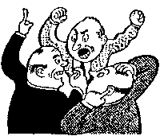
Behavior in Groups – Group Performance
Bir elin nesi var, iki elin sesi var
Nerde cokluk, orada…….
Which one is true? Under what conditions group perfromance is better than an ind.’s performance?
Types of Group Activities:
Additive tasks
Conjunctive tasks
Disjunctive tasks
Subdivided tasks

Slide 22
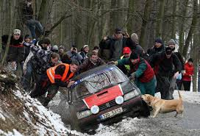
Behavior in Groups – Group Performance
Additive tasks: Success is sum of each person’s effort
The total effort to accomplish task is the sum of effort of each individual.
Ex: A group of friends try to pull out a car stucked in a mud
Group productivity > productivity of one person
Larger the group- greater the productivity

Slide 23
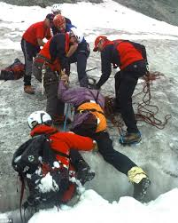
Behavior in Groups – Group Performance
Conjuctive Task: Success depends on least competent member.
All group members must succeed for the group to succeed.
A false move by any person could danger the whole mission of the group.
Ex: if a group is tied together when climbing a mountain, every member is essential &if even one does not keep up, the group is ineffective.
Often; individual performance > group's performance.
Group productivity is only as good as the
least competent member (weakest link)
Successful coordination among group
members is required.
Group productivity > productivity of one person
Larger the group- greater the productivity

Slide 24
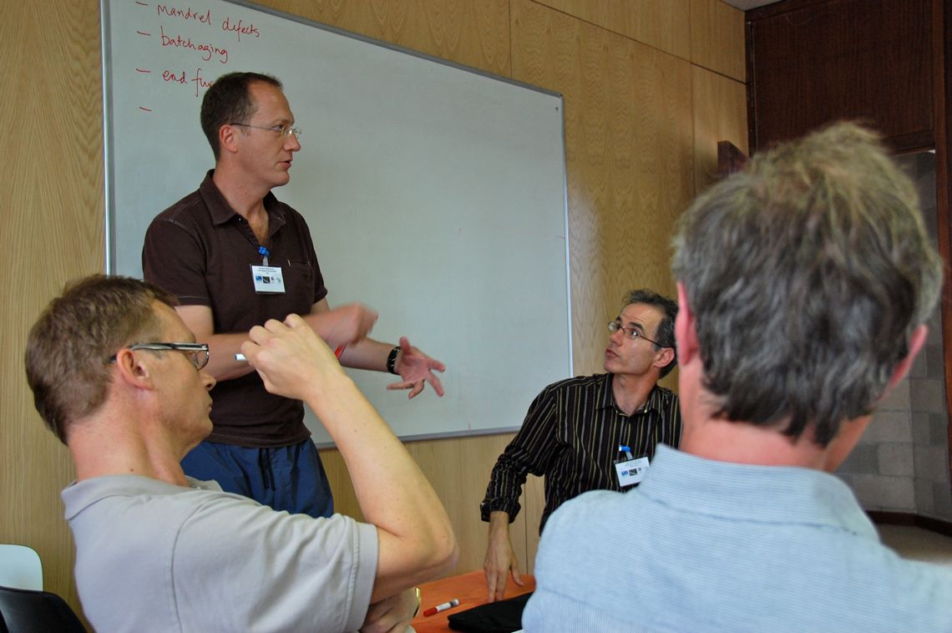
Behavior in Groups – Group Performance
Disjunctive Task: Success depends on the most competent member.
Only one person needs to solve the problem for the entire group to succeed.
Ex: A research group trying to solve a complex mathematical problem. (Any one person coming with the right answer ensures group effectivity)
Group productivity increases with the group size.

Slide 25
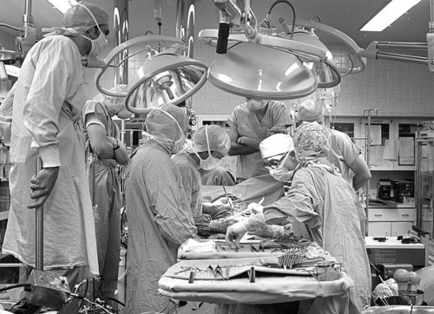
Behavior in Groups – Group Performance
Subdivided Task: Sometimes group has a complex task that can be divided among group members.
Group productivity depends not only on the best & worst player but also group’s ability to coordinate often under time pressure.
Success depends on both skill & coordination
Ex: In a medical operating room the success of the heart transplant depends on the skill of a team of proffessionals (surgeon, anesthesiologist, technicans)

Slide 26
Behavior in Groups – Group Performance
Brainstorming: Group members work together to generate many new ideas or solutions to a problem
Group members thinking of as many different suggestions as they can in a short time.
Ex: In an advertisement company your execute manager asks you to develop catchy slogans for the advertisement of a new brand of toothpaste
Alex Osborn (1957)- developed to technique to in order to enhance the productivity & creativity of problem solving groups
The ground rules for brainstorming:
Express all ideas taht come to mind, even if they sound crazy
Quantity is wanted; the more ideas the better
Don’t worry your ideas are good or bad & don’t criticise the others’, they can be evaluated later
All ideas belong to the group; memebers can bulid on each other’s work.

Slide 27
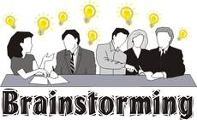
Behavior in Groups – Group Performance
Despite the popularity of this technique, research shows that individuals usually produce more and better ideas working alone
Why brainstroming is ineffective?
Social loafing
Production blocking
Evaluation Apprehension
Strategies to improve the performance of brainstorming groups:
Create heterogenous groups
Use electronic brainstorming

Slide 28
Behavior in Groups – Group Decision Making
How groups arrive at a joint decision?
Decision rules: Rules about how a group should reach a decision
When discussing matters of opinion, groups tend to use a majority-rules decision rule.
Ex: Whether the new yearbook cover should be green or blue
(No objectively correct opionion)
The group goes along with the position that has most supporters.
When discussing matters of fact, groups tend to use a truth-wins decision rule. (One solution correct; others wrong)
Group members are persuaded by the truth of particular position even if it was initially held by only minority.
Strict rules; unanimous decisions
Ex: guilt verdict in a murder case (dissent of even one juror will result in a retrail.
Unanimous are harder to reach but tend to leave group members more satisfied.

Slide 29
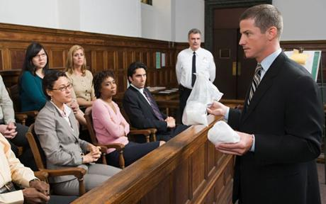
Behavior in Groups – Group Decision Making
Groups do not necessarily make wise decisions bec. they are vulnerable to special social forces that can bias decision-making.
Two problematic issues in group decisions;
Group Polarization
Group Think

Slide 30
Behavior in Groups – Group Decision Making
Group Polarization: Group discussion may lead to more extreme decisions.
Several explanations;
Persuasive arguments theory : due to new information as a result of listening pro & con arguments.
The more numerous & persuasive arguments in favor of a position- the more likely group members adopt the position.
If most members initially support one position; they will be more likley to be affected pro arguments.
Self-presentation theory : Group members concerned with how their opinions compare with others.
Desire to be seen +ly, confident & bold may lead ind.s to shift their positions to the extreme:

Slide 31
Behavior in Groups – Group Decision Making
Social identity theory: Discussions cause ind.s to focus on their group membership & identification with group
Identification leads to conforming the group
Rather than percieve the avarage opinion of the group; perceive the group norm as more extreme or stereotyped.
Group decisions do not always result in polarization;
If members of a group are evenly split, groups compromise rather than polarize (Depolarization).

Slide 32
Behavior in Groups – Group Decision Making
Groupthink: process of faulty decision-making that can occur in groups (Janis, 1982)
Ex: On January 28, 1986- Challenger launched from the Kennedy Space Center. After 72 sec., the spacecraft exploded, killing everyone on board.
Although expert engineers warned against launched, top decison makers disregarded the advice.
Janis (1982) identified antecedents of groupthink:
Highly cohesive groups (isolate themselves from outside opinions)
The group has a strong leader & the group is under stress
Group members become more concerned with group acceptance than correctness
Group members censor themselves, do not do a full information search, & evaluate information in a biased way.

Slide 33
Janis’s
Theory
Of
Group-
think

Slide 34
Behavior in Groups – Group Decision Making
How to overcome groupthink?
Leader remains impartial and encourages the expression of dissent.
Leader must be willing to accept criticism
Use separate subcommittees to discuss same issue separately & then bring these seperate groups together & discuss again.
Appoint “devil’s advocates”- a person that challenges group ideas.
Consult outside experts
Group members tend to discuss shared rather than unshared information (Common Knowledge Effect)
Groups may also use meetings to confirm rather than challenge their initial beliefs (Confirmation Bias)
Thus while groups have the potential to make better decisions than individuals, they do not always do so.

Slide 35
Group Interaction: Competition vs. Cooperation
Sometimes people in groups interact cooperatively (e.g.; help each other, share info.; at other times they compete (e.g.; put their individual goals first, try to outperform)
Social psychologists interested in understanding this phenomenon by designing lab. studies.
Classical Laboratory Studies:
Use of laboratory games that stimulate features of everyday interactions.
Two popular games;
The Trucking Game & The Prisoner’s Dilemma
Participants in laboratory studies on competition tend to compete, even when cooperation would be a more rewarding strategy.

Slide 36
Group Interaction: Competition vs. Cooperation
The Trucking Game: designed by Deutsch & Krauss (1960)
Two person Game: Participants asked to imagine they were running a trucking company (Acme Company or Bolt Company)
Goal: Get the truck from one point to another as soon as possible.
No competiton btw. Trucks ( different destinations & differentstarting points)
The fast route converged at one point (the only way to use the road would be for one them wait)
Also each player had a gate across direct route that could be raised by pressing button (it blocks the use of converging route
Alternative route: no conflict of roads but much longer.
Participants fought for use of converging routes, raised gates, ended up losing points, made nasty comments.

Slide 37
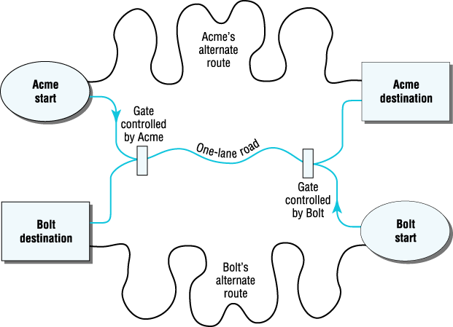
Road Map of the Trucking Game

Slide 38
Group Interaction: Competition vs. Cooperation
The Prisoner’s Dilemma: Two suspects at police station
Two suspects committed a crime together, no proof
Two suspects are put into seperate rooms;
Two alternatives; confess or not
If neither confesses- no major crime conviction but minor punishments
If one of them confesses & the other does not; confessor will be released , the suspect will get the maximum penalty.
In research, participants play for money or points
Each player’s reward depends on the actions of both player & partner.
As the game progresses, the number of cooperative choices goes down.

Slide 39
Prisoner’s Dilemma: a game used by researchers to study cooperation and competition. Example of Prisoner’s Dilemma Game:

Slide 40
Typical Prisoner’s Dilemma Game Matrix or Reward structure
Pete’s payoff is shown in blue &
Joe’s in gray
Choice X is cooperation
Choice Y is competitive

Slide 41
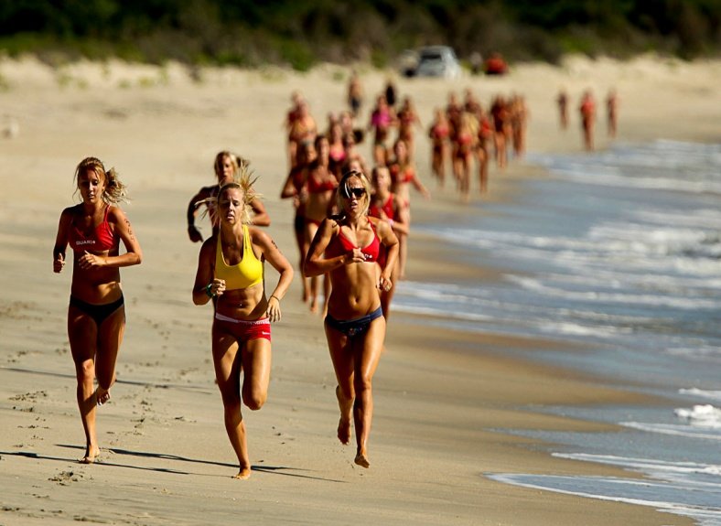
Group Interaction: Competition vs. Cooperation
Determinants of Competition vs. Cooperation
Reward Structure
Personal Values
Communication
Reciprocity
Culture

Slide 42
Group Interaction: Competition vs. Cooperation
Reward Structure: The social interdependence among group members determines the reward structure of the situation.
Competitive reward structure: one person’s gain is, another’s loss.
Ex: Olympic swimming match; only one person can win gold medal
Individual does best when others poorly- competitive interdependence.
If you want reward- compete
Cooperative reward structure: Group members are linked in a pos. way
Ex: For a soccer team to win games, teammates must work together
The better each player does, the more likely the entire team will win.- cooperative interdependence
If you want reward- cooperate

Slide 43
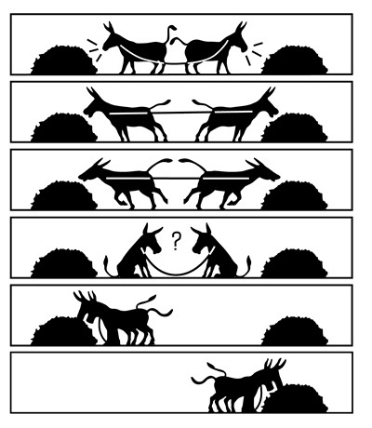
Group Interaction: Competition vs. Cooperation
Personal Values: Individual differences in people’s personal values about competition.
Three value orientations:
Cooperators; maximize the joint rewards received by both partner & self
Competitors; maximize own gain relative to those of partner (better than partner)
Individualist; maximize own gain; no concern for the loss/gain of partner
Value orientation has a strong impact on
ind.’s initial beh.s on trucking game/
prisoner’s dilemma.

Slide 44
Group Interaction: Competition vs. Cooperation
Communication: More comminication- more cooperation
In the prisoner’s dilemma game;
Competition greatest- when no communication was possible
When partners allowed to talk & see each other; cooperation increased more than 70% of trials.
Reciprocity: Initial competition provokes more competition; initial cooperation encourages further cooperation.
Reciprocal concessions (the parties take turns by giving up little)- strategy to foster cooperation.
Timing important- a person who gives too much in a time may appear weak & other will not reciprocate
Concessions must be gradual & sequental (only slightly larger than those made by other person)

Slide 45
Group Interaction: Competition vs. Cooperation
Culture: Individualist cultures- more competitive;
Collectivist cultures- more cooperative
The United States has one of the most competitive cultures on earth.
Madsen (1971); 8 years old children played marbles with same-sex children from their own culture.
Mexican children cooperated on 7 of 10 trials; American children only 1 trial in 10
People living in cities - more competitive
People high SES - more competitive
Cultural values about competition are conveyed at home, at school, through the media,and through sports and games

Slide 46
Behavior in Groups: Leadership
The Leader: The leader of a group is the person who has the most impact on group behavior and beliefs.
Give orders, make decisions, serves as a model, offers encouragement
Leadership can be formal / informal
Leaders may be appointed, elected, or emerge over time
Two kind of activities;
Task activities; leader controls, shapes, directs & organizes the group while carrying out tasks
Social activities; leader concerns with emotional & interpersonal aspect of group interaction.
Effective leadership requires performing both of the activities.

Slide 47
Behavior in Groups: Leadership
Leaders adopt different styles of leadership.
Fiedler’s (1978, 1993) Contingency Model of Leadership:
Task –Oriented Leadership: higher priority to accomplishment of tasks; putting relations second.
Relationship Oriented (Interpersonal) Leadership: higher priority given to emotions & interpersonal relationships among group members.
Task-oriented & Relationship Oriented leaders differ in their effectiveness depending on the situation.
Task-oriented leaders are most effective in high-control and low-control situations, while relationship oriented leaders are more effective in moderate-control situations.

Slide 48
Behavior in Groups: Leadership
What makes a good leader?
Two opposing views; personal characteristics vs. situation
The great-person theory of leadership suggests that leaders possess particular characteristics.
‘Some people are born to be leaders’.
Studies comparing the characteristics of leaders & followers
Abilities & skills, Interpersonal relationships, Motivation
Excelling in abilities that meet the group’s goals; intellectual ability, organized, emotionally stable, strong interpersonal skills; high motivation;ambitious, achievement oriented; confident; optimistic.
An interactive perspective focuses on the match between the needs of the situation and the characteristics of the person.
Different situations require different qualities in a leader.

